Slide 1
Sheet Vision
EE/CPRE/SE 492 Fall 2019, Team sddec19-13
Members: Ricardo Faure, Bryan Fung, Garrett Greenfield,
Trevin Nance, Walter Svenddal
Faculty Advisor: Alexander Stoytchev

Slide 2
Project plan
sddec19-13

Slide 3
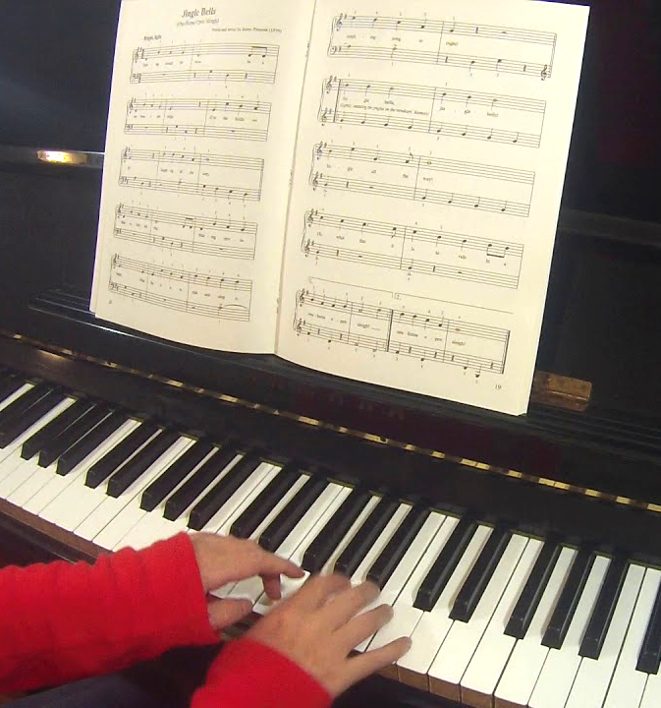
Problem Statement
sddec19-13

Slide 4
Problem Statement
Sheet music is helpful, but it’s:
Hard to read
Hard to learn from
Hard to “hear the music”
sddec19-13

Slide 5
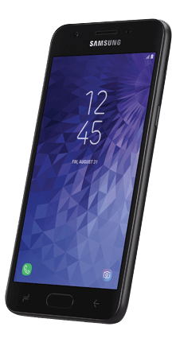
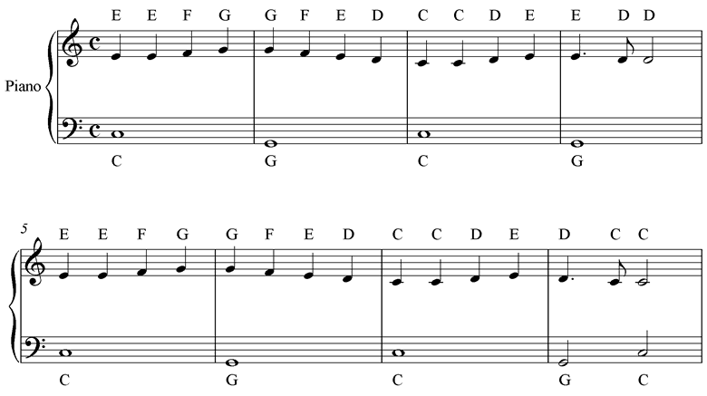
Problem Statement
sddec19-13

Slide 6
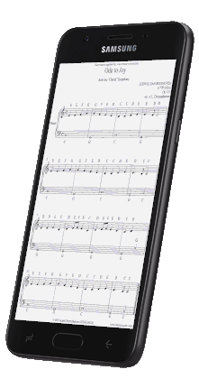
Problem Statement
sddec19-13

Slide 7
Problem Statement
sddec19-13

Slide 8
Functional Requirements
App can take picture & send it to backend CV algorithm.
CV algorithm identifies sheet music components.
CV algorithm translates symbols to a music data structure.
Data sent back to app, and app plays music based on data.
App shows a piano being played while music is played.
sddec19-13

Slide 9
Non-Functional Requirements
Computer vision algorithm should be able to analyze the sheet music in less than 15 seconds.
Algorithm should detect most beginner music symbols.
Application’s music playback should “sound as accurately as possible”.
sddec19-13

Slide 10
Constraints and Considerations
Multi platform application.
Different styles of sheet music.
Many different symbols to interpret in sheet music.
What is “Beginner sheet music”?
Operating conditions (Lighting, Camera quality).
Computer vision may be computationally expensive.
sddec19-13

Slide 11
Risks
Encrypting requests to the server.
Legality (Photography/Storing of copyrighted music).
sddec19-13

Slide 12
Market survey
Sheet Vision
Single line only.
Only creates MIDI file.
Musescore
Existing created sheet music.
Does not show how to play.
Playscore
Poor UI.
Misaligned progress bar.
Does not show how to play.
sddec19-13

Slide 13
System Design
sddec19-13

Slide 14
Functional Decomposition
User scans or selects a sheet music from their gallery and sends it to the server.
User watches a preview of how to play in accordance to the sheet music.
User plays the piano to simulate the sheet music.
sddec19-13

Slide 15
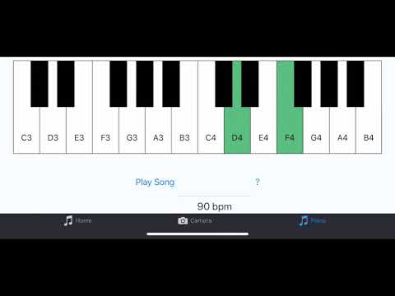
Video Demo
sddec19-13

Slide 16
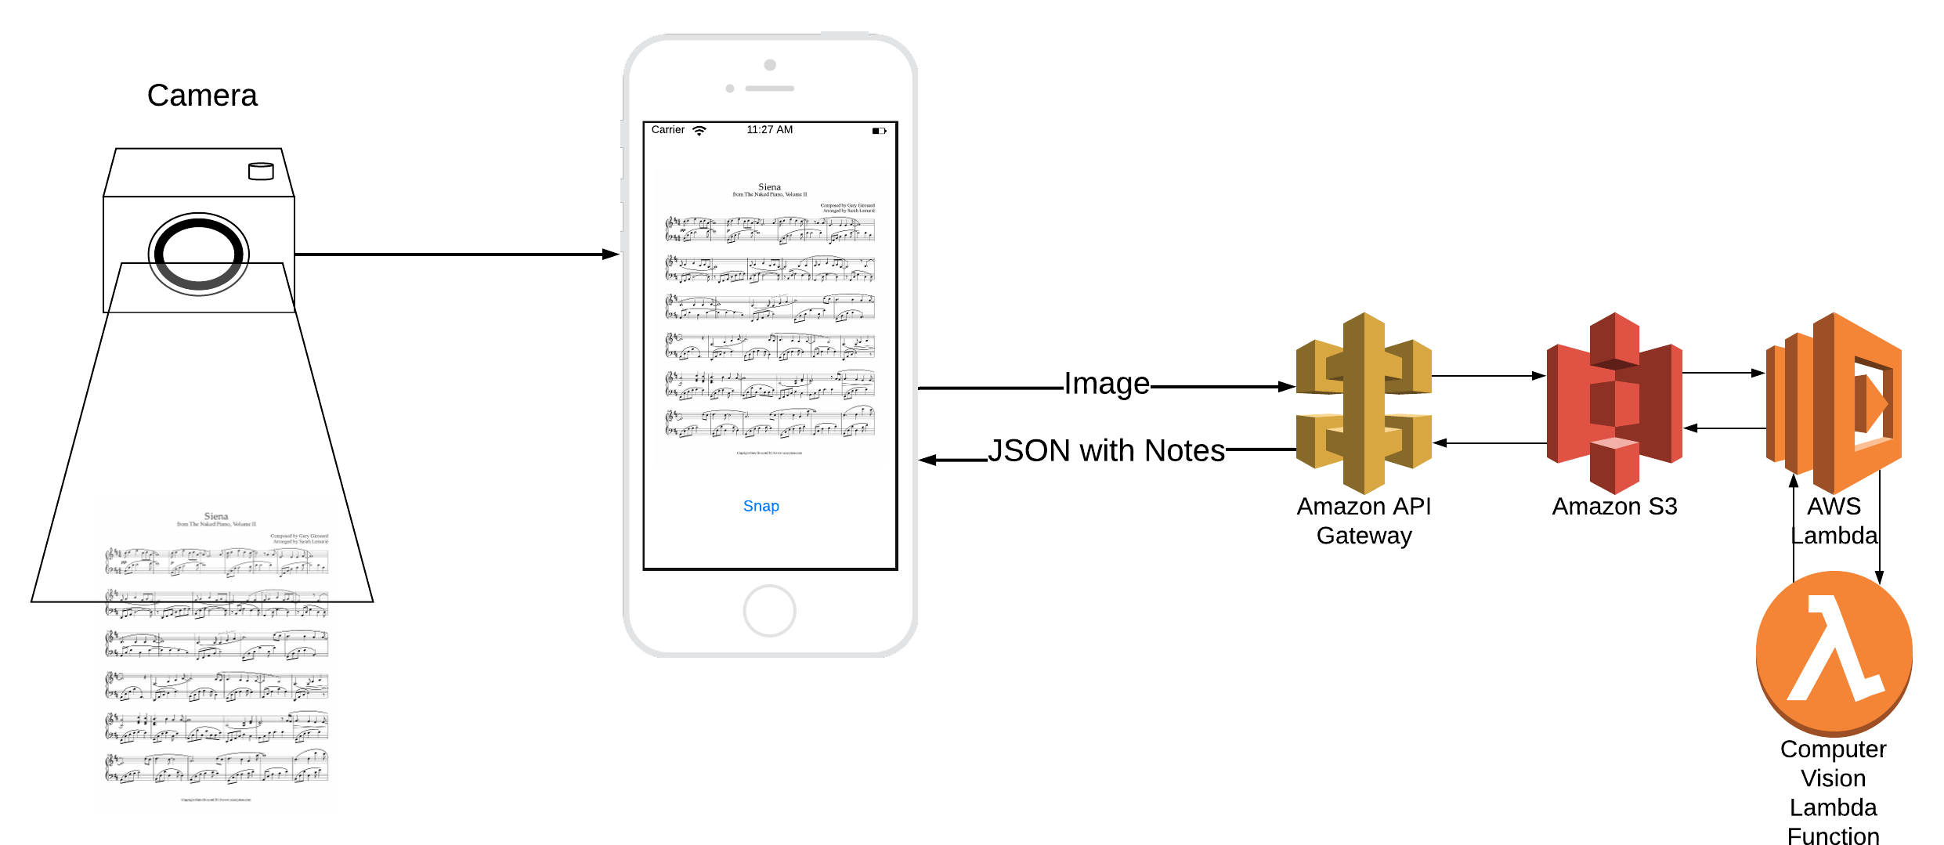
General Architecture
Backend: AWS
Lambda, S3, API Gateway
OpenCV 4.0
Python 3.6
Frontend: React Native/Expo
Modular
Multiplatform
Javascript
sddec19-13

Slide 17
How does AWS work?
AWS API Gateway
REST API, sends/receives data to different Amazon Web Services.
AWS S3
Buckets contains application files.
Files can trigger Lambda functions.
AWS Lambda
Write serverless code in any language.
Return data back in a response, or post back data into S3.
sddec19-13

Slide 18
Computer Vision Algorithm
Runs on AWS in four stages:
Image sectioning .
Staff/Bar identification.
Note extraction.
Note mapping and JSON construction.
sddec19-13

Slide 19
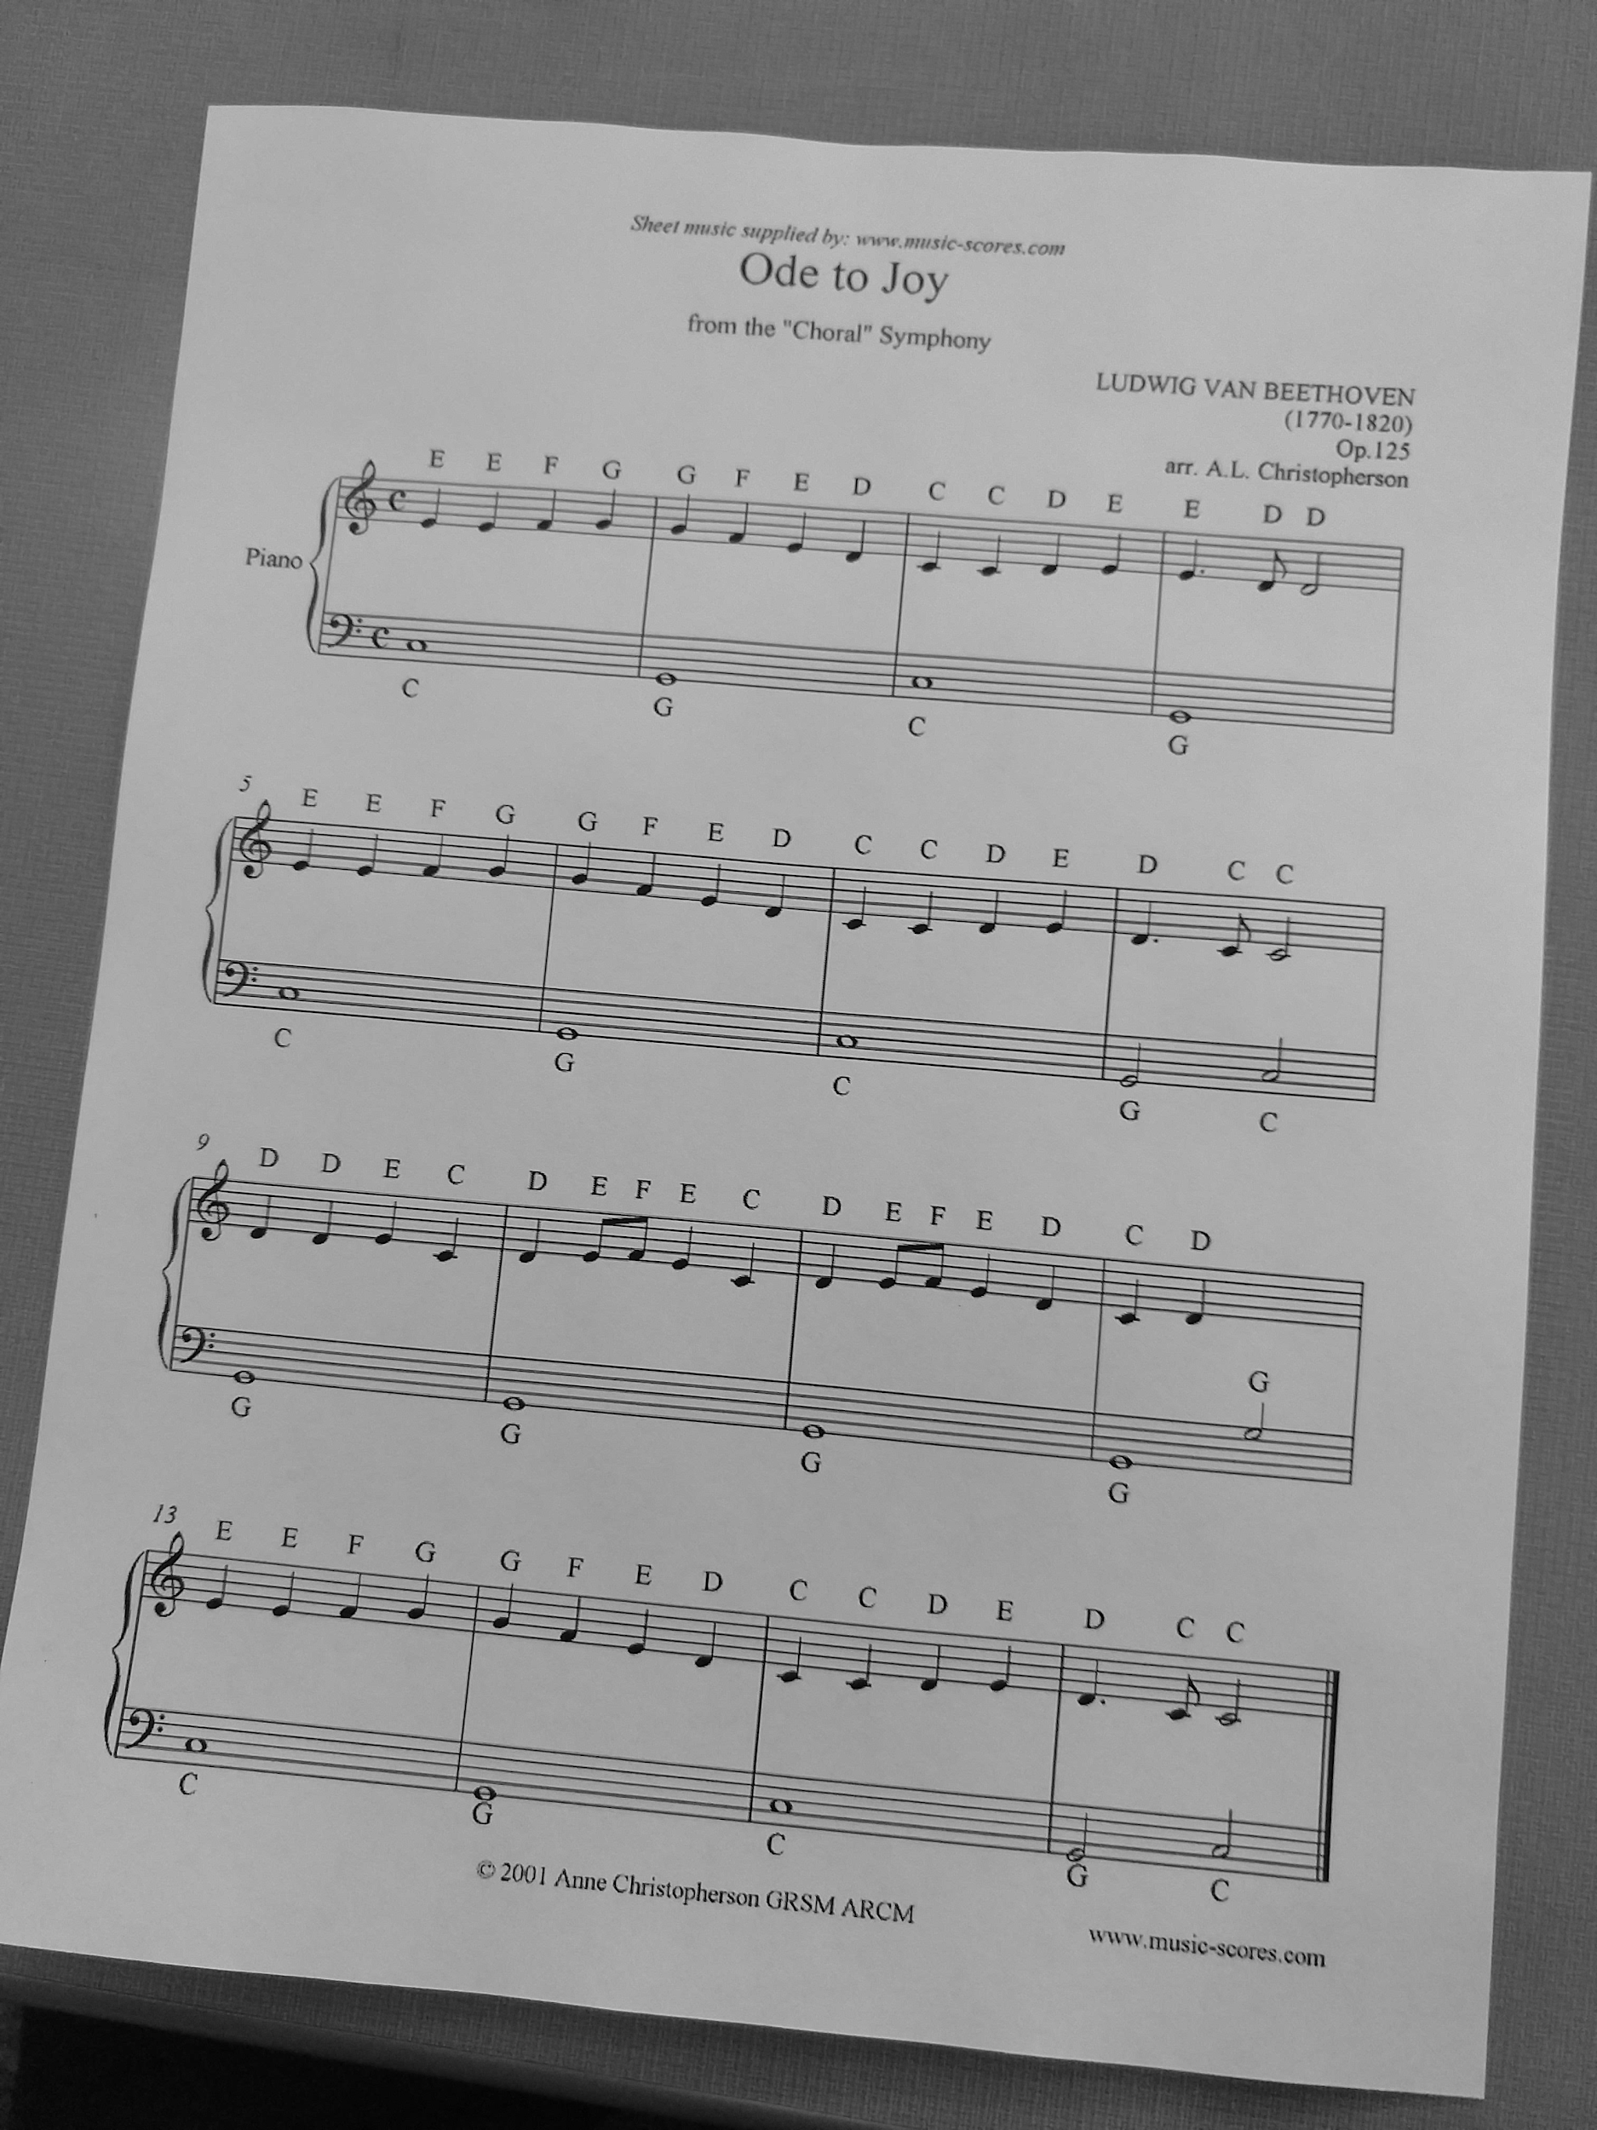
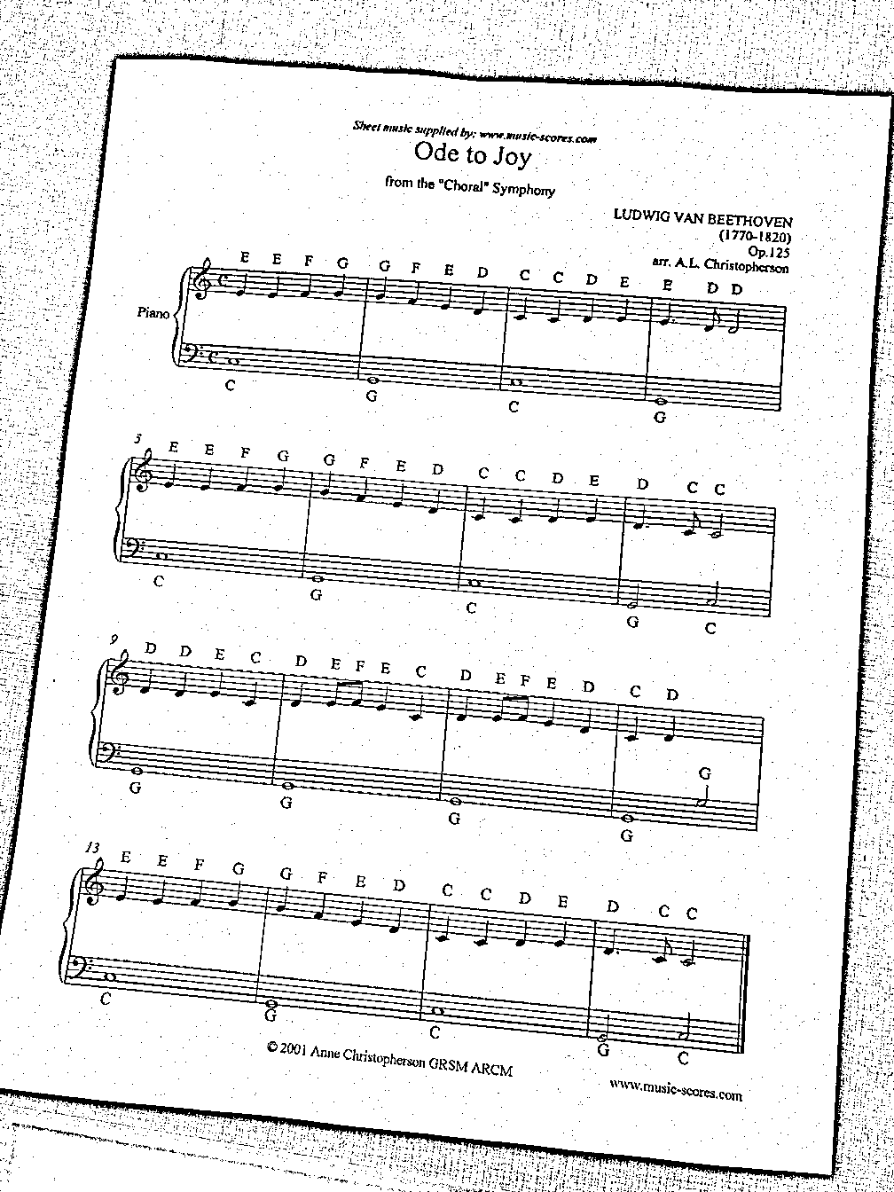
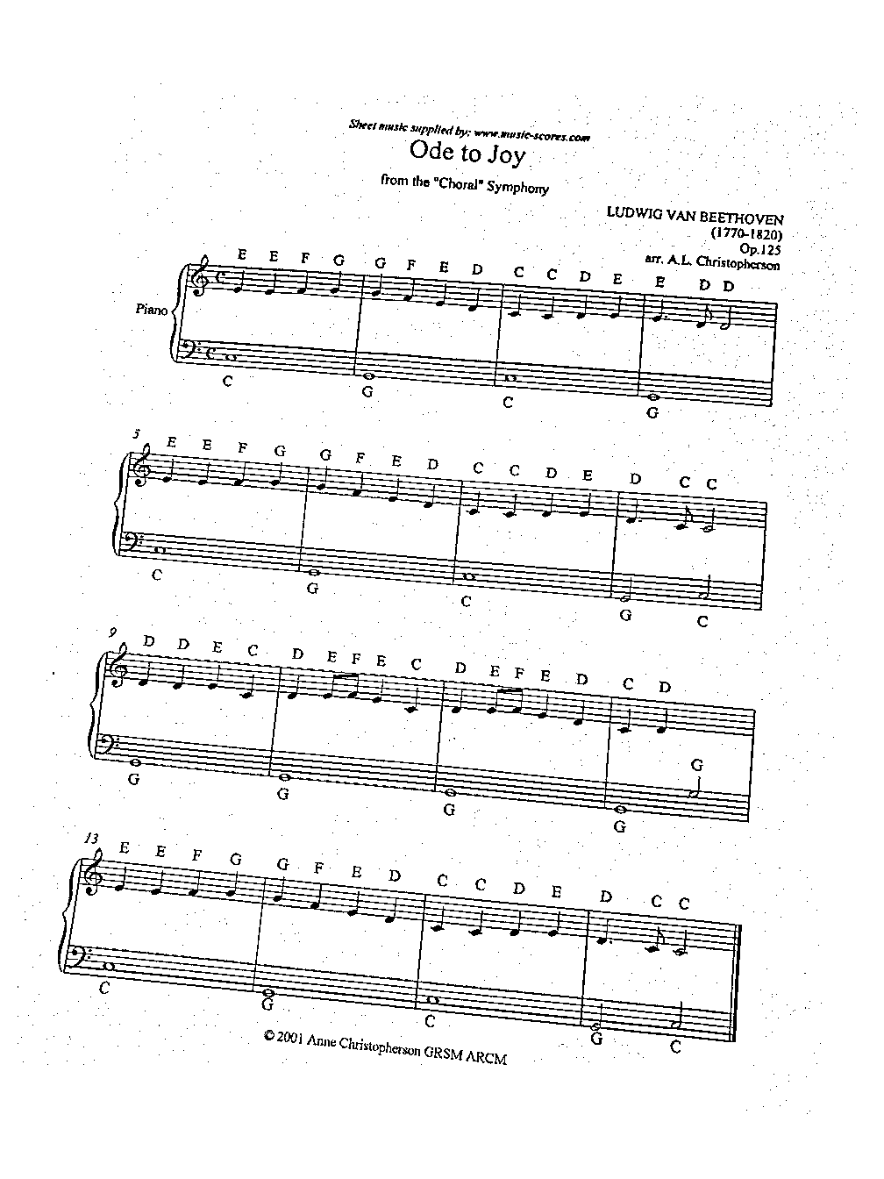
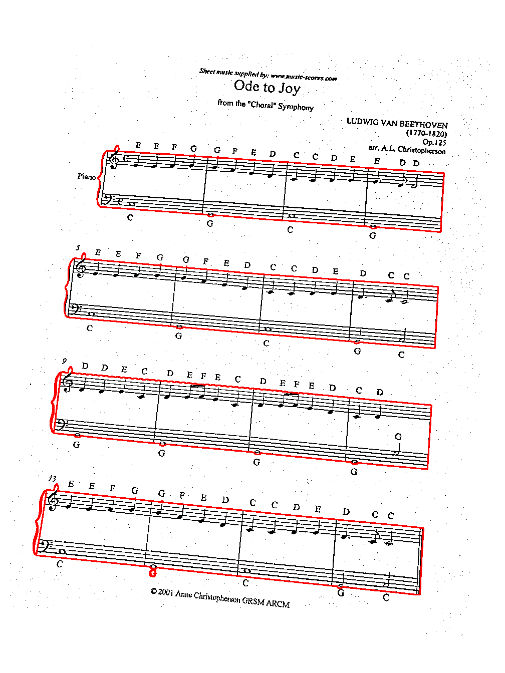
1. Image Sectioning
Convert to Grayscale
Gaussian Threshold (Fixes lighting differences)
Find Contours (Find largest white object, erase all else)
Find Contours (Find largest black objects)
sddec19-13

Slide 20
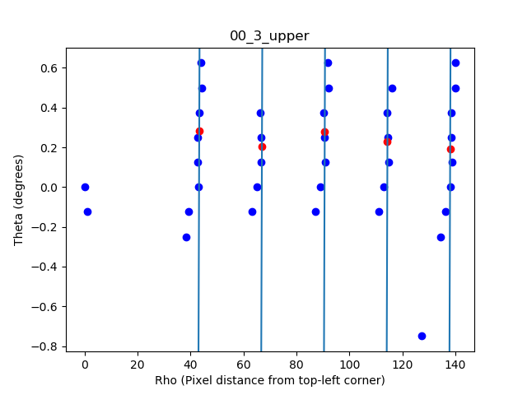
2. Staff/Bar Identification
Hough lines (Find all fitting lines in the image)
Hough lines dual space (Each blue dot is a line)
Five custom lines found from Hough lines
sddec19-13

Slide 21
3. Note Detection
sddec19-13

Slide 22
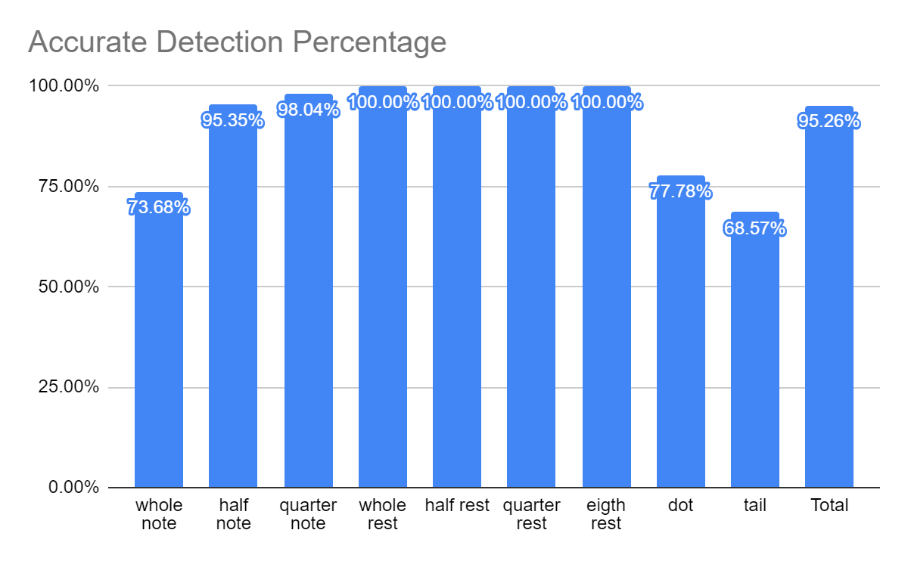
4. Notes To Music Data Structure
* there were very few whole, half and eighth rests
sddec19-13

Slide 23
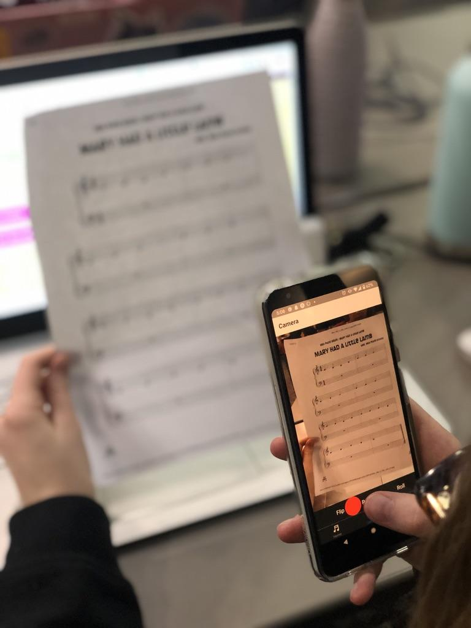
Test Plan
AWS Lambda Testing Suite
Request Tests
Functional Testing
Application usability
Algorithm accuracy
Audio “smell test”
Community Testing
sddec19-13

Slide 24
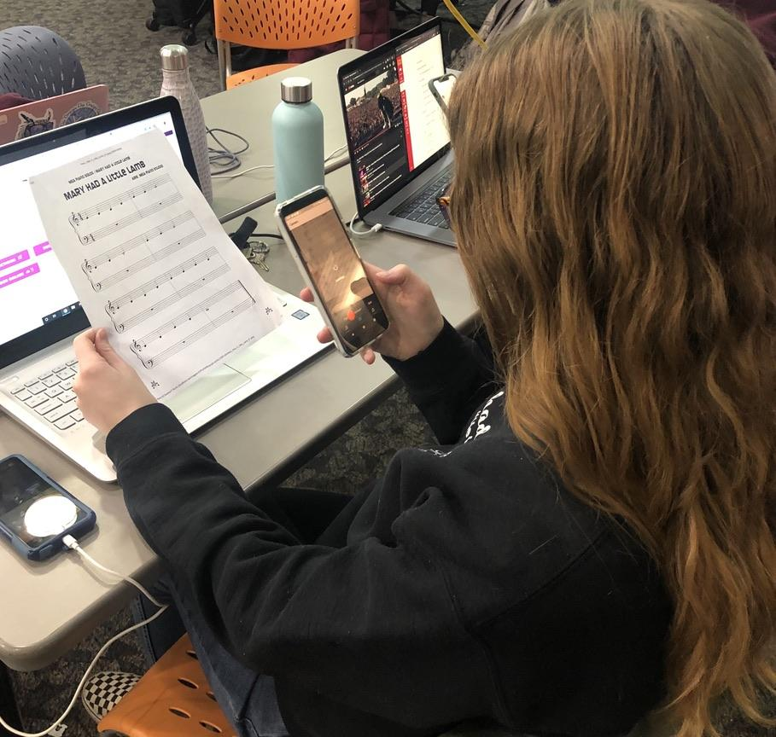
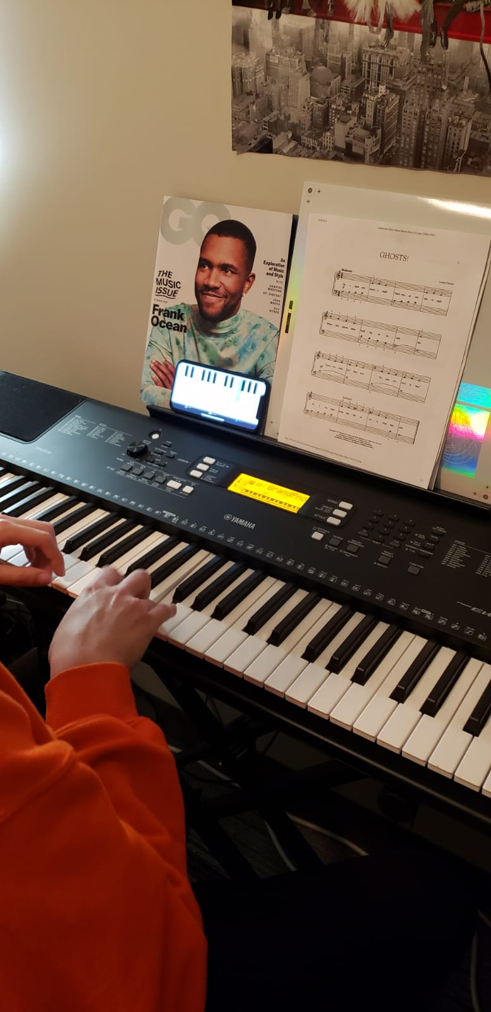
sddec19-13

Slide 25
Risks Mitigations
Requests sent are unencrypted.
No user data is ever collected or sent to our databases.
No risk to our users data.
PUT and GETS to AWS lambda only allowed by our client.
Data being posted to our S3 buckets and processed is ignored if not of the correct format.
Legality
Sheet music stored only temporarily on app/backend.
Not distributing copyrighted material.
sddec19-13

Slide 26
Challenges -Backend
React-Native doesn’t allow requests to and from pages with no Authorized SSL certificates.
No way to add our EC2 server to Certificate Authorities on Mobile, especially since it’s self-signed.
AWS Lambda request sizes are limited to 10 MB (images can be larger sometimes).
Machine Vision algorithm requires clear images (compression wasn’t an option.)
AWS S3 triggers don’t support POST.
sddec19-13

Slide 27
Innovations
Strange request structure to accommodate for limitations.
PUT request to S3 (base64 string of image).
S3 triggers lambda function on upload.
Store result back in S3.
Get average of how long a request returns.
Add on the standard deviation.
Have client GET the output from S3 after given time.
sddec19-13

Slide 28
Challenges -Computer Vision
Image sizing issues
Broke symbol detection.
Solved by dynamically sizing symbol templates.
Accuracy issues
Still an issue.
Reduced by using dynamically sized templates.
Reducing runtimes
sddec19-13

Slide 29
Challenges -Frontend
Expo libraries
Lack of documentation & examples.
Cross Platform diversity.
Constraints between Expo and React Native.
Technologies
React Native.
sddec19-13

Slide 30
Conclusion
sddec19-13

Slide 31
Current Project Status
App main functionalities work as described.
Machine vision model completed.
AWS connected with every component.
Communication between server and app fully functional.
sddec19-13

Slide 32
Future Implementations -Frontend/Backend
Use more well-known development platform
Android Studio, XCode, React Native.
Multiplatform code very inconsistent. Could be easier to work with platforms indepently.
Continue with AWS
Fantastic platform for hosting applications
Research more about limitations and interactions with client platforms before finalizing our choices.
sddec19-13

Slide 33
Future Implementations -Machine Vision
Improve performance.
Improve accuracy.
sddec19-13

Slide 34
Task Responsibility/Contributions
Name | Responsibility
Bryan Fung | Frontend Developer
Garrett Greenfield | Frontend Developer
Ricardo Faure | Frontend/Backend Architect
Trevin Nance | Machine vision Engineer
Walter Svenddal | Machine vision Engineer
sddec19-13

Slide 35
Acknowledgement
Thank you ISU Engineering Department and Dr. Daniels for providing us with this opportunity.
We would like to thank our faculty advisor Dr. Stoytchev for his support and great feedback.
sddec19-13

Slide 36
Questions?
sddec19-13

